Slide 1
Summer School. In-company vocational training and capacitation worldwide - a contribution to innovation and transformation in business and society (ProETIT)
Basics and general conditions of professional education and training. An example in the field of renewable energies in Cuba
Prof. Dr. Ing. Osvaldo Romero Romero
SRH Berlin University of Applied Science
12/09/2022

Slide 2
Introduction
Current challenges like globalization, information society and scientific-technological innovation are questioning the traditional training systems, forcing them to reform and redefine their objectives, functions and intervention instruments.
Training today is also developing the ability to order, interpret and judge the numerous and varied information that is received, in order to be able to give intelligent and responsible answers.
Training systems in general, and those of technical education and vocational training in particular, must be able to offer effective alternatives to the jobs that new technologies and new organizational and social systems destroy (and create); which implies adding to the traditional path of training processes other paths of acquisition and recognition of more open and flexible qualifications.

Slide 3
Introduction
The open nature of the labor market makes it necessary to train professionals for the world and not just for specific places or countries and with a focus on lifelong learning.
The necessary adaptation and updating of the skills acquisition process requires that professional training be supported by solid basic training (scientific-technical, cultural and social)
How many participate/who or are related to the professional training process? What aspects at the macro, meso, and micro levels of socioeconomic life should be taken into account in the design of vocational training systems and curricula?
This contribution will deal with these questions to give way to the debate and contributions of the participants, expanding on the subject, exposing experiences, discovering new questions and/or proposing alternative solutions.

Slide 4
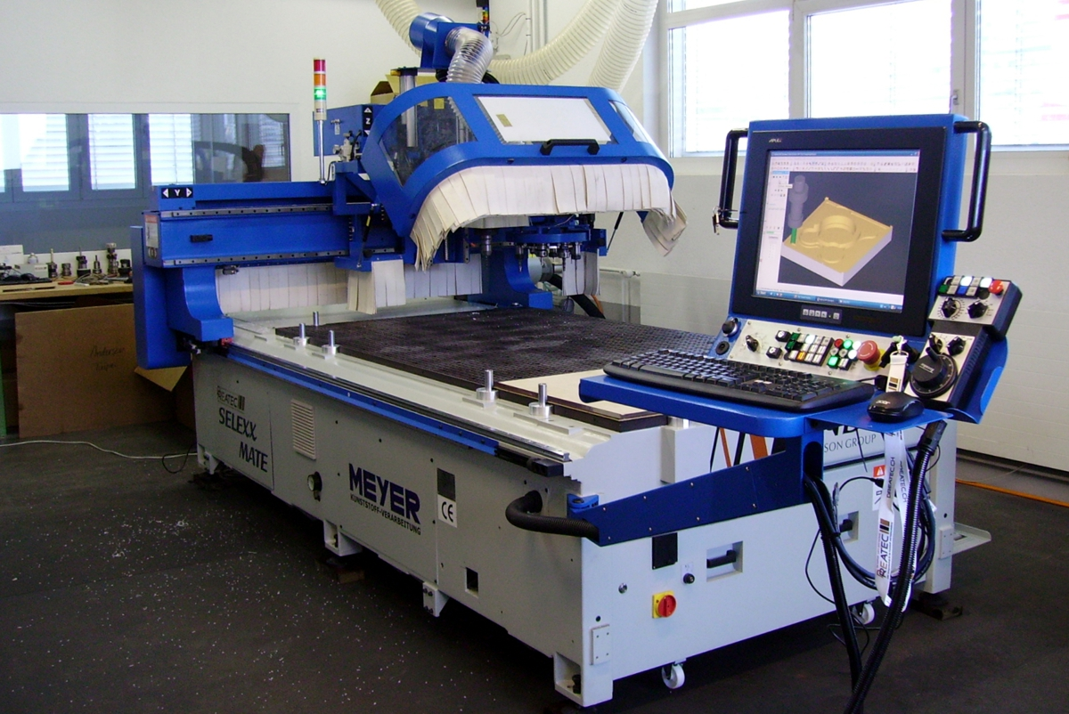
Work Life - Craft
What can I do? (and what the machine?)
carpentry about 1950
modern CNC-machine
in a carpentry

Slide 5
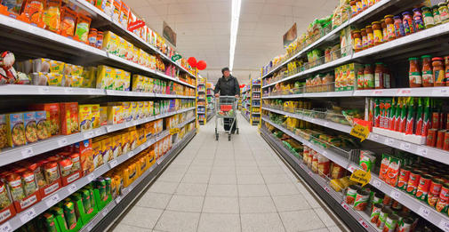
Work Life – Trade
More is more?
grocery store about 1960
today‘s supermarket

Slide 6
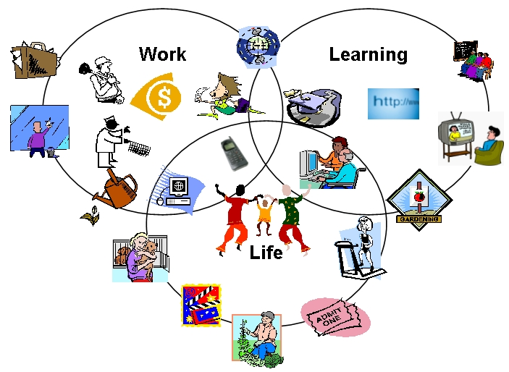
Manual work and intellectual work in today's world
Taxi drivers worldwide are increasingly using a GPS system to find and take passengers to their destination, instead of the traditional thick map-books.
Bread delivery truck drivers in Mexico City use GPS to plan their distribution routes and thus save on fuel and running costs.
Youngs under 25 years of age are designing virtual content for distance education through technologies incorporated in mobile phones.
Questions
Are the traditional professional skills sufficient for the requirements of the new jobs?
What value do the skills acquired in traditional jobs have for new jobs that incorporate technological innovations?
How to certify and recognize the skills previous acquired?
What role do culture in general and work culture in particular play in the acquisition and update of professional skills?

Slide 7
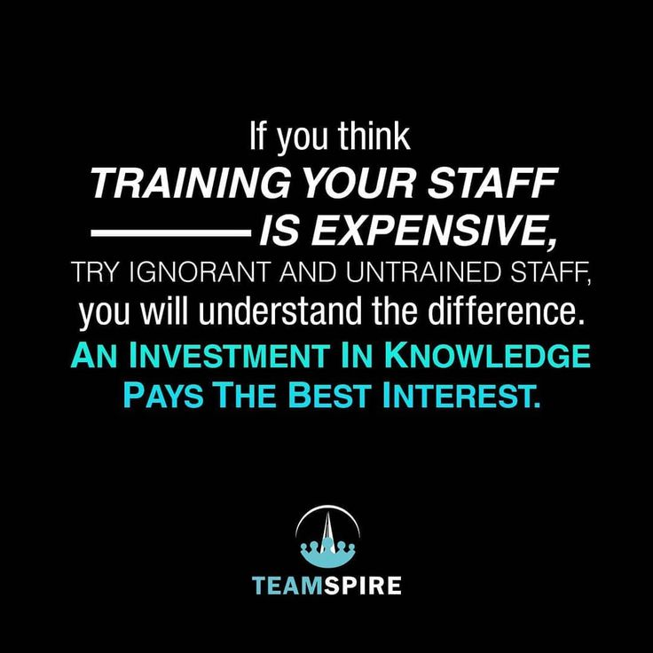

Slide 8
Forces impacting training and qualification processes
Economic cycles
Globalization
Value of intangible assets and human capital
Focus on links to business strategy
Changing demographics and diversity
Generational differences
Talent management
Customer service and quality emphasis
New technology
High-performance models of work systems

Slide 9
Main stakeholders in the professional training and qualification processes
Macro level
The government and its ministries
The chambers of commerce, industry and other sectors.
Professional associations.
The society as a whole.
Meso level
Technical and vocational schools
The universities.
Production and service companies.
The branches of professional associations at the territorial level.
Micro level
Trainers and teachers of technical and professional education.
Trainers and teachers from professional associations and companies.
Schools and national bodies for training and certification of professional skills
Regulatory and quality evaluation entities
Schools and bodies for training and certification of professional skills on the territory.
Regulatory and quality evaluation entities
Labor unions.
Trainees and their families.
Professionals with explicit needs to update their skills.

Slide 10
Key elements in the development of vocational training systems
Macro level
National policies for the labor market and entrepreneurship
Regulations of the ministries of education and/or higher education.
Role and regulations of the chambers of commerce, industries and other branches.
Participation and recognition of professional associations at the country level.
Meso level
Adoption of policies and regulations in educational institutions and the business sector.
Adaptation of the work culture in the business sector to the recommendations of the chambers of the different sectors.
Level of activity of professional associations at the middle level
Professional relations between educational institutions, business sector, chambers and professional associations.
Micro level
Professional skills of teaching staff to interpret and implement policies and regulations and their adoption at the level of educational institutions and companies.
Competencies of trainers and evaluators in professional associations and companies.
Availability of material and financial resources in educational institutions and the business sector for vocational training.
Social representation of vocational training.

Slide 11
Macro level
Is there a framework of professions and qualifications that is broad in scope to all business sectors?
Are there structures for the systematic assessment of current and future skills demands?
Is there coherence between educational policies, the framework of professions and qualifications and economic development policies?
What is the social perception of vocational training at a macro level?
Meso level
Do schools, universities, companies and professional associations have adequate capacities to face the process?
Do companies include comprehensive professional development programs for their human resources in their work culture?
Have the companies identified the main competencies that are demanded and could be demanded?
Are there curricula that respond to the skills requirements of the economic sectors and are flexible to changes in demand?
Are there specific agreements between schools, companies and universities to ensure the sustainability of vocational training?
Are curricula managed in a shared way between educational centers and companies?
Macro level
Are there teachers with adequate skills to effectively implement the curricula?
Do universities have adequate education and training systems for vocational training teachers?
Are there sufficient material and financial resources in universities, schools and companies for the sustainable implementation of the curricula?
Are there career guidance programs to attract apprentices and workers to participate in the courses?
Main questions to answer at each level

Slide 12
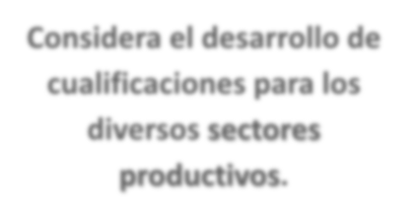
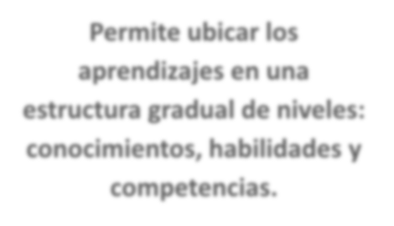
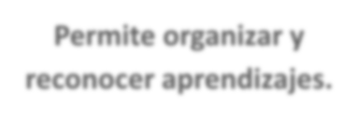
¿What is a professions and Qualifications Framework?,
Establishes a legal and political framework that considers the development of professions and qualifications for all the sectors.
It is a guide and reference instrument for vocational training and the labor market.
It allows organizing and recognizing learning, as well as certifying and valuing professional skills.
It allows learning to be located in a gradual structure of levels: knowledge, skills and competences.

Slide 13
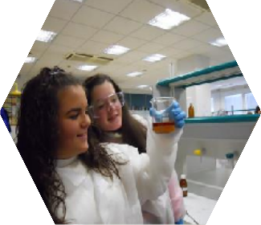
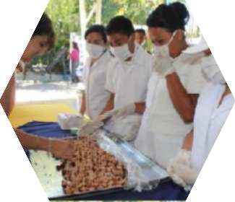
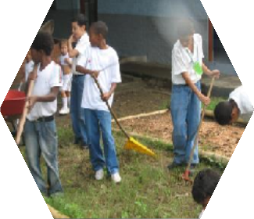
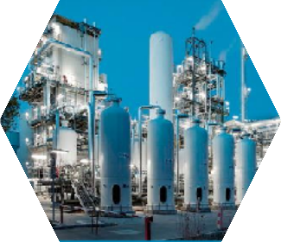
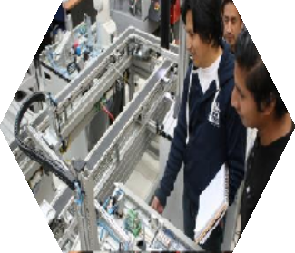
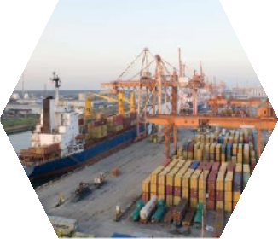
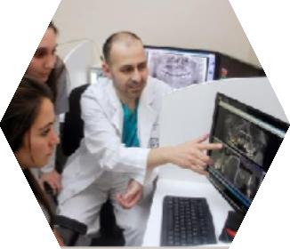
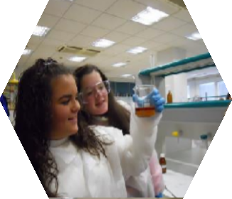
What is a professions and qualifications framework for?
It facilitates the social inclusion of all citizens.
Contributes to the creation of relevant Quality Criteria.
Provides opportunities to actively participate in the world of work
Promotes the development of human capital.
Valid credentials that expand training and employment opportunities.
Lifelong learning (formal and non-formal) possibility of reconversion
Companies can trust that people have the skills/ competences
Institutions respond to the needs of the productive world and people.
The system recognizes the trajectory of people.
Productive sector participates in training processes.
Facilitates adaptation to changing contexts.
Companies access the professional profiles they require in a timelier manner.

Slide 14
The Needs Assessment Process
Training
Pressure Points
Person Analysis
Organizational Analysis
- Is it a training problem?
- Who needs training?
- Are employees ready
for training?
- Support for training?
- Sufficient resources?
- Fit with strategic
objectives?
Task Analysis
- identify tasks,
skills, knowledge,
curricula development

Slide 15
Training Programme Elements
Ensuring Employees’ Readiness for Training
Creating a Learning Environment
Conducting Needs Assessment
Developing an Evaluation Plan
Ensuring Transfer of Training
Select Training Method
Monitor and Evaluate the Program

Slide 16
Systematic Training Design

Slide 17
An example in the field of renewable energies in Cuba

Slide 18
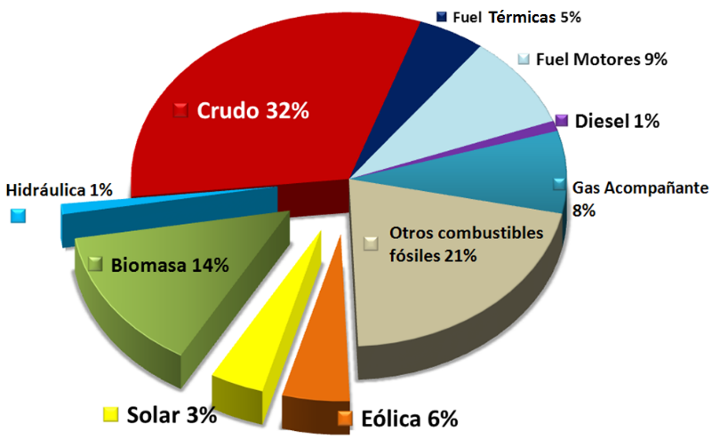
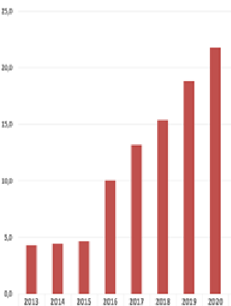
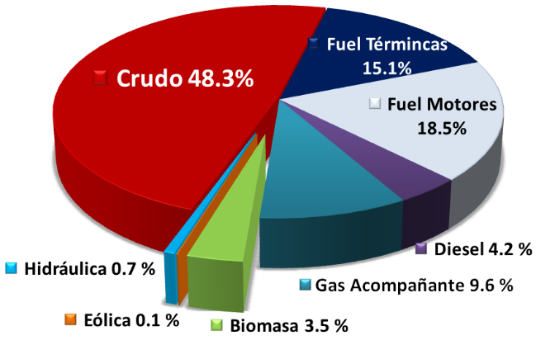
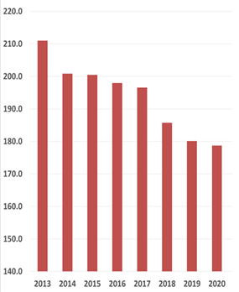
Planned Results 2030
24%
Aumento % de utilización de las FRE.
24
Matriz eléctrica
Structure of power generation 2013
%
25
20
15
10
5
0
2013 2014 2015 2016 2017 2018 2019 2020
Reducción de los costos de la energía entregada
Reducir la contaminación ambiental
Low use of renewable energy sources (FRE). Power generation with RES only 4.3%.
1150
1100
1050
1000
950
900
22,0
21,0
20,0
19,0
18,0
17,0
16,0
15,0
14,0
21.1
1127
Centavo USD / kWh
17.9
g CO₂ / kWh servidos
1018
2013 2014 2015 2016 2017 2018 2019 2020
2013 2014 2015 2016 2017 2018 2019 2020

Slide 19
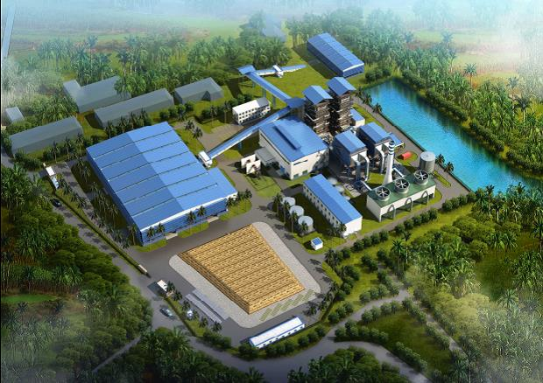
Installations in operation of Renewable Sources
Renewable Energy Sources Program
 | Tecnologías | Instalado | Instalaciones
 | Bagasse | 470 MW | 57 Sugar Mills
 | Eólica | 11,1 MW | 4 Parques Eólicos
 | Solar Fotovoltaica | 37 MW | 22 Parques Solares Fotovoltaicos
 |  | 5543 | Escuelas Rurales
 |  | 467 | Consultorios médicos
 |  | 1882 | Salas TV Rurales
 |  | 2500 | Viviendas aisladas
 | Hidroenergía | 66 MW | 149 Hidroeléctricas
 | Biogás | 0,82 MW | 5 Plantas
 | Biomasa no cañera | 0,50 MW | 4 Plantas
Instalar 2144 MW en nueva potencia eléctrica
19 Bioeléctricas: 755 MW. Bagasse based facility
14 Parques eólicos: 633 MW
Parques Solares Fotovoltaicos: 700 MW
74 Pequeñas Centrales Hidroeléctricas: 56 MW
Otras fuentes potenciales
Energía Solar Térmica
Biomasa Forestal
Desechos Sólidos Urbanos
Residuos Orgánicos Industriales y de la Agricultura
Central Azucarero “Ciro Redondo – Ciego de Ávila”

Slide 20
Vocational training and qualifications for renewable energies in Cuba
Macro Level
Cuba lacks an updated vocational training framework, the existing one hat a lot of weakness influenced by the tradition and economical context.
The development of renewable energy sources is not supported by the current professional training system.
The social perception of professional training and qualification does not favor the motivation of apprentices and workers.
There is no adequate diagnosis of the professional skills required according to the types of renewable sources at the macro level.
There is no a catalog of qualifications required for renewable energies.
There is an erroneous belief that renewable energies can be managed with the electrical and mechanical engineers currently trained. UNSUSTAINABLE OVERQUALIFICATION.

Slide 21
Vocational training and qualifications for renewable energies in Cuba
Meso Level
Currently the plants are operated by university graduates from various specialties, Overqualified but with insufficient specific skills for the job.
There is no adequate diagnosis of the professional skills required according to the types of renewable sources by the companies.
Schools, universities and companies lack resources for specialized training on the subject.
There are no curricula focused on the life cycle of renewable technologies (design, manufacturing, construction and assembly, operation and maintenance, development and exploitation of databases and information sources, dismantling and waste management)
Work is being done on the design of a curriculum for a higher university technician, but the process is going slow.

Slide 22
Vocational training and qualifications for renewable energies in Cuba
Micro Level
Poor theoretical knowledge and practical experiences on renewable energy technologies of the university professors who train trainers and the active trainers in vocational schools and companies.
Schools, companies and universities need to requalify their trainers of trainees with focus on the renewable energy technologies.

Slide 23
Thank you very much

